Slide 1
CluedIn Fundamentals: Deduplication project
Alternative approach to identifying and merging duplicate records as part of building a single, unified customer view

Slide 2
Explore the concept of a deduplication project
When to use a deduplication project
Training agenda
How to work with a deduplication project
Demo of a deduplication project

Slide 3
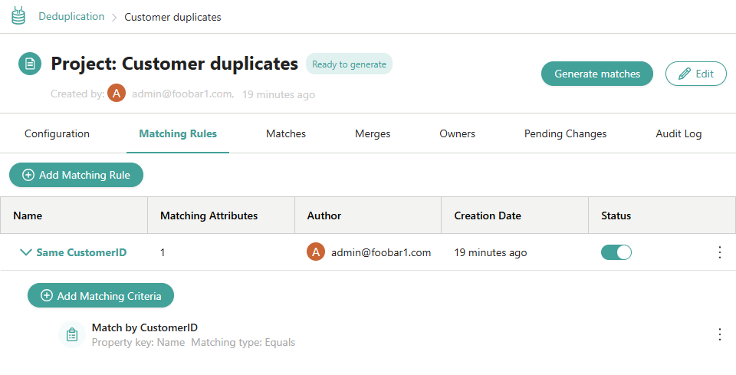

What is a deduplication project?
A deduplication project in CluedIn allows you to identify, manage, and resolve duplicate records by merging them into a single, accurate, and consolidated golden record.
Unlike merging by identifiers, a deduplication project operates on the existing golden records and requires you to configure specific conditions to identify duplicates.

Slide 4


When to use a deduplication project?
You should use a deduplication project when:
Your records cannot be merged by identifiers—meaning they lack a shared property that reliably links records across different source systems.
You want to apply complex conditions to determine which golden records should be checked for duplicates, as well as to specify detailed matching logic.

Slide 5
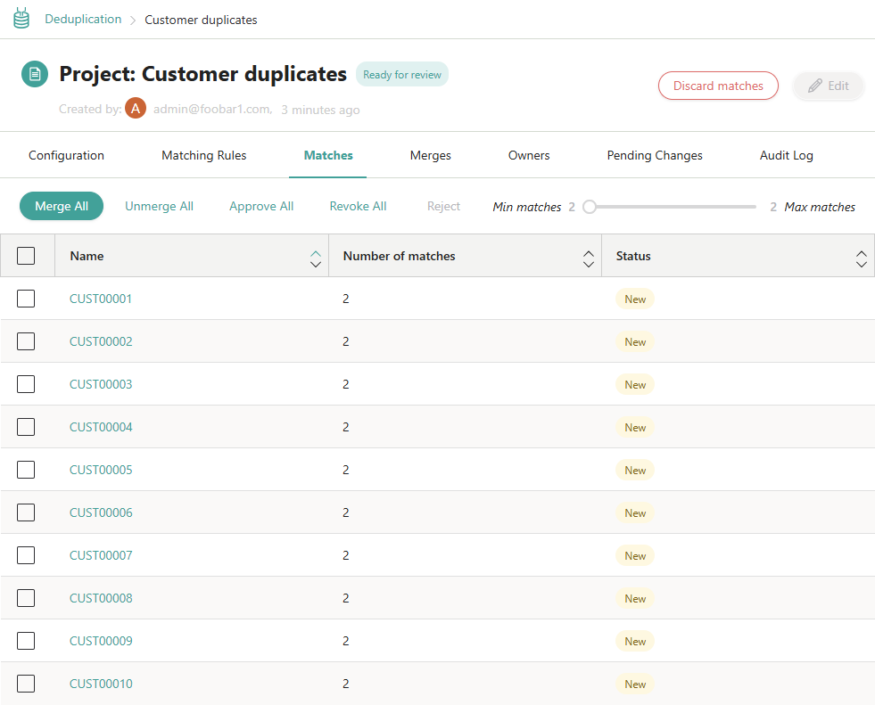



Working with a deduplication project involves four steps:
Choose the project type
Set up matching rules
How to use a deduplication project?
Generate matches
Process groups of matches

Slide 6
DEMO: Using a deduplication project to merge duplicate CRM and ERP records

Slide 7
Demo summary
You’ve seen how to:
Create a deduplication project
Configure matching rules
Review and merge groups of duplicates
Outcome:
Duplicate CRM and ERP records are merged into a consolidated golden record.
Important:
You do not need to replicate this process yourself, as a deduplication project is not recommended for our specific use case.

Slide 8
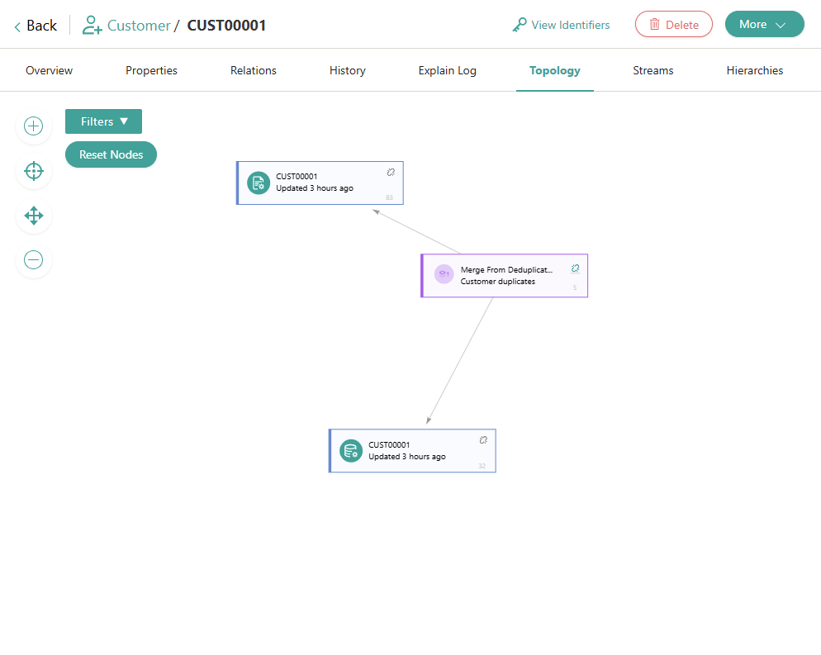


Learn more about a deduplication project in our documentation portal.
Next session: Strategies for defining the uniqueness of records.
What’s next?

